Slide 1
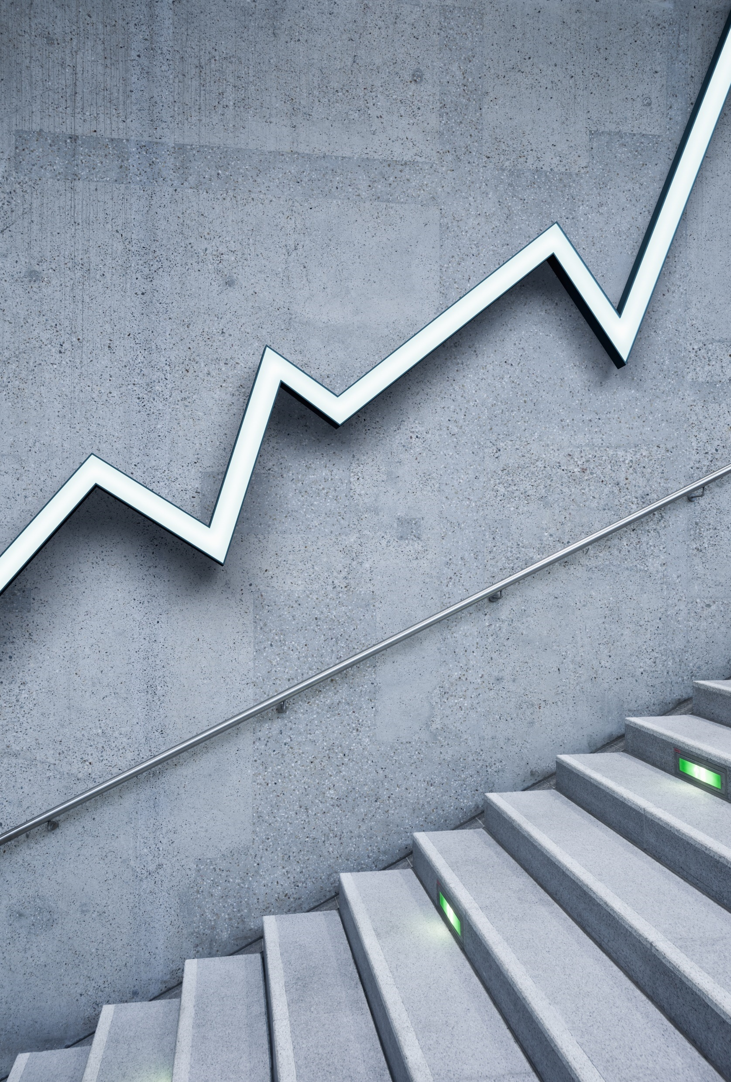
Big Mountain Resort
Mackenzie Unger

Slide 2
Problem Identification: - Big Mountain Resort installed an additional chair lift, which has increased operating costs by $1,540,000 this season. - Big Mountain Resort has been underpricing their tickets.

Slide 3
Recommendations: - Increase ticket prices to around $90. - Increase the vertical drop feature of the resort by opening an additional run lower down the mountain. - Close a less popular run to help reduce operating costs.

Slide 4
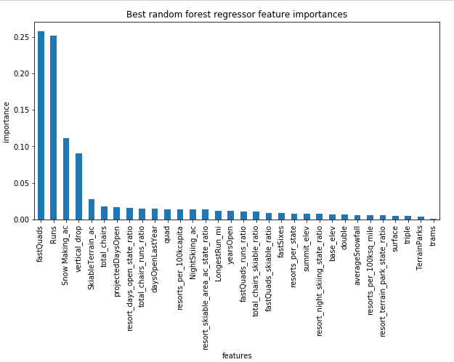
Increase Ticket Price:
Random Forest Model:
modelled price is $94.22
actual price is $81.00
Even with the expected mean absolute error of $10.39, this suggests there is room for an increase.
Random Forest Important Features:
Fast Quads
Runs
Snow Making
Vertical Drop

Slide 5
Increasing Vertical Drop: - As seen in previous graph, vertical drop is an important feature. - Scenario Suggestion: Increase the vertical drop by adding a run to a point 150 feet lower down, install an additional chair lift to bring skiers back up, and add 2 acres of snow making cover.
This scenario increases support for ticket price by $9.75 Over the season, this could be expected to amount to $17,068,841

Slide 6
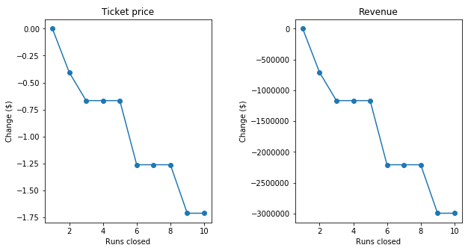
Closing a run:
The closing of 1 run does not effect our price or revenue
Closing 2 or 3 runs will cause a sharp decrease
Closing 4 or 5 runs is no different than closing 3 runs
Note:
In the previous suggestion we opened a run, so if we do open another run, we could possibly close a 2nd run without causing the price to drop.

Slide 7
Conclusion: - The Random Forest Model supports the increase of our ticket price to $94 with all of our features as is. - Increasing our vertical drop helps support our increased ticket price, though this does need the installation of another chair lift, supports a $9 increase in ticket price. - Closing runs helps decrease operational costs, however closing too many decreases our ticket price.
Any combination of these will help to increase our revenue for this coming season. I would suggest increasing ticket prices to $90 and working with Marketing to highlight our excellence in the important features. We can close one run with out effecting our ticket price, and that will help to cut operational costs.

